Slide 1
Chapter 6
Loops

Slide 2
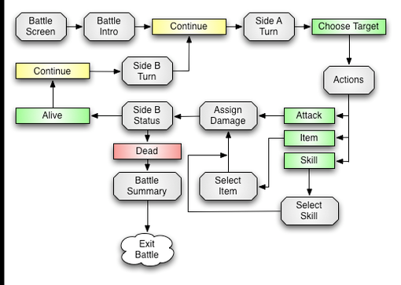
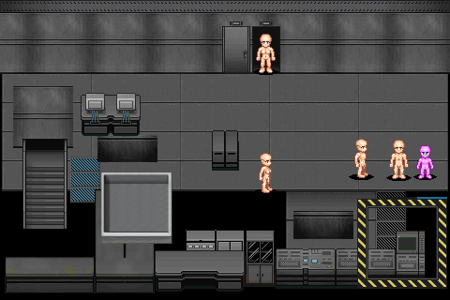


https://www.youtube.com/watch?v=EZ6r_BXWgE0 https://www.youtube.com/watch?v=MwPbzAyhM0E

Slide 3
Iteration Statements
C’s iteration statements are used to set up loops.
A loop is a statement whose job is to repeatedly execute some other statement (the loop body).
In C, every loop has a controlling expression.
Each time the loop body is executed (an iteration of the loop), the controlling expression is evaluated.
If the expression is true (has a value that’s not zero) the loop continues to execute.

Slide 4
Iteration Statements
C provides three iteration statements:
The while statement is used for loops whose controlling expression is tested before the loop body is executed.
The do statement is used if the expression is tested after the loop body is executed.
The for statement is convenient for loops that increment or decrement a counting variable.

Slide 5
The while Statement
Using a while statement is the easiest way to set up a loop.
The while statement has the form
while ( expression ) statement
expression is the controlling expression; statement is the loop body.

Slide 6
The while Statement
Example of a while statement:
while (i < n) /* controlling expression */
i = i * 2; /* loop body */
When a while statement is executed, the controlling expression is evaluated first.
If its value is nonzero (true), the loop body is executed and the expression is tested again.
The process continues until the controlling expression eventually has the value zero.

Slide 7
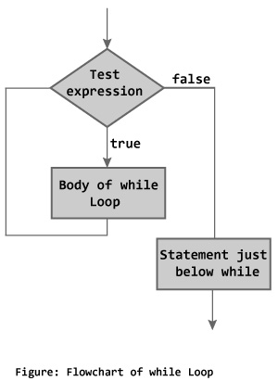
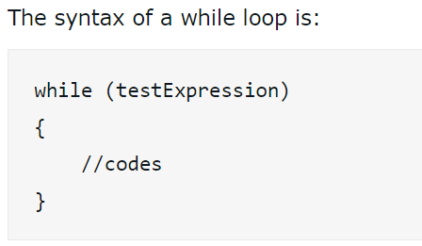

Slide 8
The while Statement
A while statement that computes the smallest power of 2 that is greater than or equal to a number n:
i = 1;
while (i < n)
i = i * 2;
A trace of the loop when n has the value 10:
i = 1; // i is now 1.
Is i < n? // Yes; continue.
i = i * 2; // i is now 2.
Is i < n? // Yes; continue.
i = i * 2; // i is now 4.
Is i < n? // Yes; continue.
i = i * 2; // i is now 8.
Is i < n? // Yes; continue.
i = i * 2; // i is now 16.
Is i < n? // No; exit from loop.

Slide 9
The while Statement
Although the loop body must be a single statement, that’s merely a technicality.
If multiple statements are needed, use braces to create a single compound statement:
while (i > 0)
{
printf("T minus %d and counting\n", i);
i--;
}
Some programmers always use braces, even when they’re not strictly necessary:
while (i < n)
{
i = i * 2;
}

Slide 10
The while Statement
The following statements display a series of “countdown” messages:
i = 10;
while (i > 0)
{
printf("T minus %d and counting\n", i);
i--;
}
The final message printed is T minus 1 and counting.

Slide 11
The while Statement
Observations about the while statement:
The controlling expression is false when a while loop terminates. Thus, when a loop controlled by i > 0 terminates, i must be less than or equal to 0.
The body of a while loop may not be executed at all, because the controlling expression is tested before the body is executed.
A while statement can often be written in a variety of ways. A more concise version of the countdown loop:
while (i > 0)
printf("T minus %d and counting\n", i--);

Slide 12
Infinite Loops
A while statement won’t terminate if the controlling expression always has a nonzero value.
C programmers sometimes deliberately create an infinite loop by using a nonzero constant as the controlling expression:
while (1) {…}
A while statement of this form will execute forever unless its body contains a statement that transfers control out of the loop (break, goto, return) or calls a function that causes the program to terminate.

Slide 13
Program: Printing a Table of Squares
The square.c program uses a while statement to print a table of squares.
The user specifies the number of entries in the table:
This program prints a table of squares.
Enter number of entries in table: 5
1 1
2 4
3 9
4 16
5 25

Slide 14
/* Prints a table of squares using a while tatement*/
#include <stdio.h>
int main(void)
{
int i, n;
printf(“Prints a table of squares.\n");
printf("Enter no. of entries in table: ");
scanf("%d", &n);
i = 1;
while (i <= n)
{
printf("%10d%10d\n", i, i * i);
i++;
}
return 0;
}
square.c

Slide 15
Program: Summing a Series of Numbers
The sum.c program sums a series of integers entered by the user:
This program sums a series of integers.
Enter integers (0 to terminate): 8 23 71 5 0
The sum is: 107
The program will need a loop that uses scanf to read a number and then adds the number to a running total.

Slide 16
sum.c
#include <stdio.h>
int main(void)
{
int n, sum = 0;
printf(“Sums a series of integers.\n");
printf("Enter integers (0 to terminate): ");
scanf("%d", &n);
while (n != 0)
{
sum += n;
scanf("%d", &n);
}
printf("The sum is: %d\n", sum);
return 0;
}

Slide 17
The do Statement
General form of the do statement:
do statement while ( expression ) ;
When a do statement is executed, the loop body is executed first, then the controlling expression is evaluated.
If the value of the expression is nonzero, the loop body is executed again and then the expression is evaluated once more.

Slide 18
The do Statement
The countdown example rewritten as a do statement:
i = 10;
do
{
printf("T minus %d and counting\n", i);
--i;
} while (i > 0);
The do statement is often indistinguishable from the while statement.
The only difference is that the body of a do statement is always executed at least once.

Slide 19
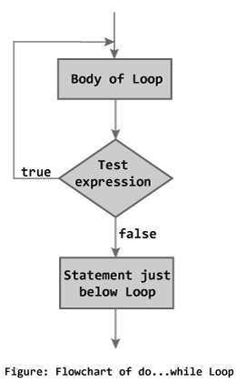
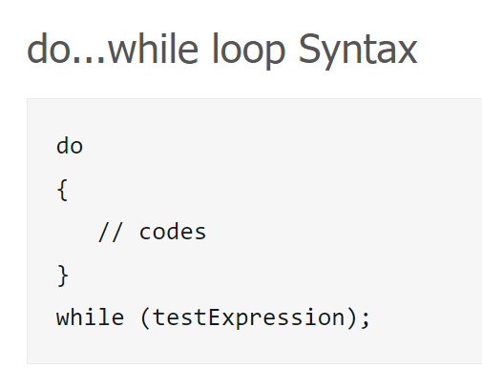

Slide 20
The do Statement
It’s a good idea to use braces in all do statements, whether or not they’re needed, because a do statement without braces can easily be mistaken for a while statement:
do
printf("T minus %d and counting\n", i--);
while (i > 0);
A careless reader might think that the word while was the beginning of a while statement.

Slide 21
Program: Calculating the Number of Digits in an Integer
The numdigits.c program calculates the number of digits in an integer entered by the user:
Enter a nonnegative integer: 60
The number has 2 digit(s).
The program will divide the user’s input by 10 repeatedly until it becomes 0; the number of divisions performed is the number of digits.
Writing this loop as a do statement is better than using a while statement, because every integer—even 0—has at least one digit.

Slide 22
// Calculates the no. of digits in an integer
#include <stdio.h>
int main(void)
{
int digits = 0, n;
printf("Enter a nonnegative integer: ");
scanf("%d", &n);
do
{
n /= 10;
digits++;
} while (n > 0);
printf("The no. has %d digit(s).\n", digits);
return 0;
}
numdigits.c

Slide 23
Example of do statement
int i = 10;
do
{
printf("Hello %d\n", i);
i = i -1;
if( i == 6 ) { break; }
} while( i > 0 );

Slide 24
The for Statement
The for statement is ideal for loops that have a “counting” variable, but it’s versatile enough to be used for other kinds of loops as well.
General form of the for statement:
for ( expr1 ; expr2 ; expr3 ) statement
expr1, expr2, and expr3 are expressions.
Example:
for (i = 10; i > 0; i--)
printf("T minus %d and counting\n", i);

Slide 25
The for Statement
The for statement is closely related to the while statement.
Except in a few rare cases, a for loop can always be replaced by an equivalent while loop:
expr1;
while ( expr2 ) {
statement
expr3;
}
expr1 is an initialization step that’s performed only once, before the loop begins to execute.
for (expr1;expr2;expr3)
statement

Slide 26
The for Statement
expr2 controls loop termination (the loop continues executing as long as the value of expr2 is nonzero).
expr3 is an operation to be performed at the end of each loop iteration.
The result when this pattern is applied to the previous for loop:
i = 10;
while (i > 0) {
printf("T minus %d and counting\n", i);
i--;
}
for (i = 10; i > 0; i--)
printf("T minus %d and counting\n", i);

Slide 27
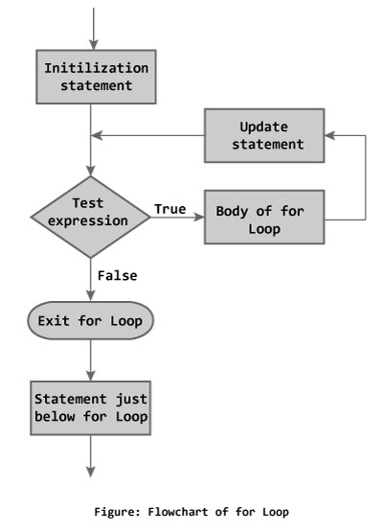
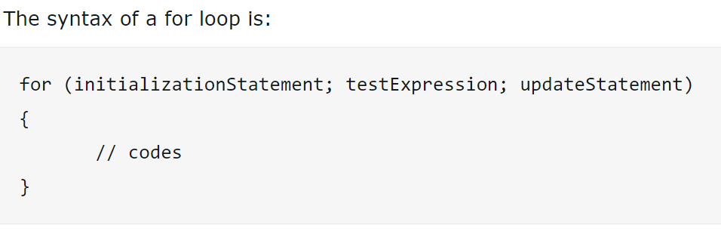

Slide 28
The for Statement
Studying the equivalent while statement can help clarify the fine points of a for statement.
For example, what if i-- is replaced by --i?
for (i = 10; i > 0; --i)
printf("T minus %d and counting\n", i);
The equivalent while loop shows that the change has no effect on the behavior of the loop:
int i = 10;
while (i > 0)
{
printf("T minus %d and counting\n", i);
--i;
}

Slide 29
The for Statement
Since the first and third expressions in a for statement are executed as statements, their values are irrelevant—they’re useful only for their side effects.
Consequently, these two expressions are usually assignments or increment/decrement expressions.

Slide 30
for Statement Idioms
The for statement is usually the best choice for loops that “count up” (increment a variable) or “count down” (decrement a variable).
A for statement that counts up or down a total of n times will usually have one of the following forms:
Counting up from 0 to n–1 : for (i = 0; i < n; i++) …
Counting up from 1 to n : for (i = 1; i <= n; i++) …
Counting down from n–1 to 0 : for (i = n - 1; i >= 0; i--) …
Counting down from n to 1 : for (i = n; i > 0; i--) …

Slide 31
for Statement Idioms
Common for statement errors:
Using < instead of > (or vice versa) in the controlling expression. “Counting up” loops should use the < or <= operator. “Counting down” loops should use > or >=.
Using == in the controlling expression instead of <, <=, >, or >=.
“Off-by-one” errors such as writing the controlling expression as i <= n instead of i < n.

Slide 32
Omitting Expressions in a for Statement
C allows any or all of the expressions that control a for statement to be omitted.
If the first expression is omitted, no initialization is performed before the loop is executed:
i = 10;
for (; i > 0; --i)
printf("T minus %d and counting\n", i);
If the third expression is omitted, the loop body is responsible for ensuring that the value of the second expression eventually becomes false:
for (i = 10; i > 0;)
printf("T minus %d and counting\n", i--);

Slide 33
Omitting Expressions in a for Statement
When the first and third expressions are both omitted, the resulting loop is nothing more than a while statement in disguise:
for (; i > 0;)
printf("T minus %d and counting\n", i--);
is the same as
while (i > 0)
printf("T minus %d and counting\n", i--);
The while version is clearer and therefore preferable.

Slide 34
Omitting Expressions in a for Statement
If the second expression is missing, it defaults to a true value, so the for statement doesn’t terminate (unless stopped in some other fashion).
For example, some programmers use the following for statement to establish an infinite loop:
for (;;)
…

Slide 35
for Statements in C99
In C99, the first expression in a for statement can be replaced by a declaration.
This feature allows the programmer to declare a variable for use by the loop:
for (int i = 0; i < n; i++)
…
The variable i need not have been declared prior to this statement.

Slide 36
for Statements in C99
A variable declared by a for statement cannot be accessed outside the body of the loop (we say that it’s not visible outside the loop):
for (int i = 0; i < n; i++)
{
…
printf("%d", i);
/* legal: i is visible inside loop */
…
}
printf("%d", i); /*** WRONG ***/

Slide 37
for Statements in C99
Having a for statement declare its own control variable is usually a good idea: it’s convenient and it can make programs easier to understand.
However, if the program needs to access the variable after loop termination, it’s necessary to use the older form of the for statement.
A for statement may declare more than one variable, provided that all variables have the same type:
for (int i = 0, j = 0; i < n; i++)
…

Slide 38
The Comma Operator
On occasion, a for statement may need to have two (or more) initialization expressions or one that increments several variables each time through the loop.
This effect can be accomplished by using a comma expression as the first or third expression in the for statement.
A comma expression has the form
expr1 , expr2
where expr1 and expr2 are any two expressions.

Slide 39
The Comma Operator
A comma expression is evaluated in two steps:
First, expr1 is evaluated and its value discarded.
Second, expr2 is evaluated; its value is the value of the entire expression.
Evaluating expr1 should always have a side effect; if it doesn’t, then expr1 serves no purpose.
When the comma expression ++i, i+j is evaluated, i is first incremented, then i+j is evaluated.
If i and j have the values 1 and 5, respectively, the value of the expression will be 7, and i will be incremented to 2.

Slide 40
The Comma Operator
The comma operator is left associative, so the compiler interprets
i = 1, j = 2, k = i + j
as
((i = 1), (j = 2)), (k = (i + j))
Since the left operand in a comma expression is evaluated before the right operand, the assignments i = 1, j = 2, and k = i + j will be performed from left to right.
j = 10;
i = (j++, j+100, 999+j); i= 1010

Slide 41
Example: Comma Operator in for Loop
j = 10;
for(i = 0; i < 10; i++)
{
... rest of loop ...
j--;
}
for(i = 0, j = 10; i < 10; i++, j--)
{
... rest of loop ...
}

Slide 42
Example: Comma Operator in for Loop
int main ()
{
for( int a = 1, b = 10, c = 1 ; a < 10; a = a + 1, b = b - 1, c = c * 2 )
{
printf(“%d, %d, %d\n”, a, b, c);
}
return 0;
}
1, 10, 1
2, 9, 2
3, 8, 4
4, 7, 8
5, 6, 16
6, 5, 32
7, 4, 64
8, 3, 128
9, 2, 256

Slide 43
Program: Printing a Table of Squares (Revisited)
The square.c program (Section 6.1) can be improved by converting its while loop to a for loop.

Slide 44
square2.c
// Prints a table of squares using a for statement
#include <stdio.h>
int main(void)
{
int i, n;
printf(“Prints a table of squares.\n");
printf("Enter no of entries in table: ");
scanf("%d", &n);
for (i = 1; i <= n; i++)
printf("%10d%10d\n", i, i * i);
return 0;
}

Slide 45
Program: Printing a Table of Squares (Revisited)
C places no restrictions on the three expressions that control the behavior of a for statement.
Although these expressions usually initialize, test, and update the same variable, there’s no requirement that they be related in any way.
The square3.c program is equivalent to square2.c, but contains a for statement that initializes one variable (square), tests another (i), and increments a third (odd).
The flexibility of the for statement can sometimes be useful, but in this case the original program was clearer.

Slide 46
// Prints a table of squares using an odd method
#include <stdio.h>
int main(void)
{
int i, n, odd, square;
printf(“Prints a table of squares.\n");
printf("Enter number of entries in table: ");
scanf("%d", &n);
i = 1;
odd = 3;
for (square = 1; i <= n; odd += 2)
{
printf("%10d%10d\n", i, square);
++i;
square += odd;
}
return 0;
}
square3.c

Slide 47
Exiting from a Loop
The normal exit point for a loop is at the beginning (as in a while or for statement) or at the end (the do statement).
Using the break statement, it’s possible to write a loop with an exit point in the middle or a loop with more than one exit point.

Slide 48
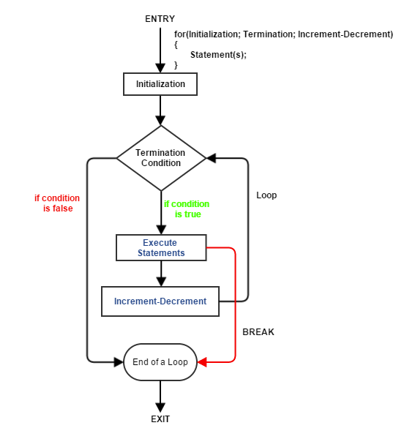
The break Statement
The break statement can transfer control out of a switch statement, but it can also be used to jump out of a while, do, or for loop.
A loop that checks whether a number n is prime can use a break statement to terminate the loop as soon as a divisor is found:
for (d = 2; d < n; d++)
if (n % d == 0)
break;

Slide 49
The break Statement
After the loop has terminated, an if statement can be use to determine whether termination was premature (hence n isn’t prime) or normal (n is prime):
if (d < n)
printf("%d is divisible by %d\n", n, d);
else
printf("%d is prime\n", n);

Slide 50
The break Statement
The break statement is particularly useful for writing loops in which the exit point is in the middle of the body rather than at the beginning or end.
Loops that read user input, terminating when a particular value is entered, often fall into this category:
for (;;) {
printf("Enter … to stop: ");
scanf("%d", &n);
if (n == 0)
break;
printf("%d cubed is %d\n", n, n*n*n);
}

Slide 51
The break Statement
A break statement transfers control out of the innermost enclosing while, do, for, or switch.
When these statements are nested, the break statement can escape only one level of nesting.
Example:
while (…)
{
switch (…)
{
…
break;
…
}
}
// break transfers control out of the switch statement, but not out of the while loop.

Slide 52
The continue Statement
The continue statement is similar to break:
break transfers control just past the end of a loop.
continue transfers control to a point just before the end of the loop body.
With break, control leaves the loop; with continue, control remains inside the loop.
There’s another difference between break and continue: break can be used in switch statements and loops (while, do, and for), whereas continue is limited to loops.

Slide 53
The continue Statement
A loop that uses the continue statement:
n = 0;
sum = 0;
while (n < 10)
{
scanf("%d", &i);
if (i == 0)
continue;
sum += i;
n++;
/* continue jumps to here */
}

Slide 54
The continue Statement
The same loop written without using continue
n = 0;
sum = 0;
while (n < 10)
{
scanf("%d", &i);
if (i != 0)
{
sum += i;
n++;
}
}
n = 0;
sum = 0;
while (n < 10) {
scanf("%d", &i);
if (i == 0)
continue;
sum += i;
n++;
}

Slide 55
The goto Statement
The goto statement is capable of jumping to any statement in a function, provided that the statement has a label.
A label is just an identifier placed at the beginning of a statement:
identifier: statement
A statement may have more than one label.
The goto statement itself has the form
goto identifier;
Executing the statement goto L; transfers control to the statement that follows the label L, which must be in the same function as the goto statement itself.

Slide 56
The goto Statement
If C didn’t have a break statement, a goto statement could be used to exit from a loop:
for (d = 2; d < n; d++)
if (n % d == 0)
goto done;
done:
if (d < n)
printf("%d is divisible by %d\n", n,d);
else
printf("%d is prime\n", n);

Slide 57
The goto Statement
The goto statement is rarely needed in everyday C programming.
The break, continue, and return statements—which are essentially restricted goto statements—and the exit function are sufficient to handle most situations that might require a goto in other languages.
Nonetheless, the goto statement can be helpful once in a while.

Slide 58
The goto Statement
Consider the problem of exiting a loop from within a switch statement.
The break statement doesn’t have the desired effect: it exits from the switch, but not from the loop.
A goto statement solves the problem:
while (…)
{
switch (…)
{
…
goto loop_done; /* break won't work here */
…
}
}
loop_done: …

Slide 59
Program: Balancing a Checkbook
Many simple interactive programs present the user with a list of commands to choose from.
Once a command is entered, the program performs the desired action, then prompts the user for another command.
This process continues until the user selects an “exit” or “quit” command.
The heart of such a program will be a loop:
for (;;)
{
prompt user to enter command;
read command;
execute command;
}

Slide 60
Executing the command will require a switch statement (or cascaded if statement):
for (;;)
{
prompt user to enter command;
read command;
switch (command)
{
case command₁: perform operation₁; break;
case command₂: perform operation₂; break;
.
case command_{n}: perform operation_{n}; break;
default: print error message; break;
}
}

Slide 61
Program: Balancing a Checkbook
The checking.c program, which maintains a checkbook balance, uses a loop of this type.
The user is allowed to clear the account balance, credit money to the account, debit money from the account, display the current balance, and exit the program.

Slide 62
Program: Balancing a Checkbook
*** ACME checkbook-balancing program ***
Commands: 0=clear, 1=credit, 2=debit, 3=balance, 4=exit
Enter command: 1
Enter amount of credit: 1042.56
Enter command: 2
Enter amount of debit: 133.79
Enter command: 1
Enter amount of credit: 1754.32
Enter command: 2
Enter amount of debit: 1400
Enter command: 2
Enter amount of debit: 68
Enter command: 2
Enter amount of debit: 50
Enter command: 3
Current balance: $1145.09
Enter command: 4

Slide 63
checking.c
#include <stdio.h>
int main(void)
{
int cmd;
float balance = 0.0f, credit, debit;
printf("***ACME checkbook-balancing program ***\n");
printf("Commands: 0=clear, 1=credit, 2=debit, ");
printf("3=balance, 4=exit\n\n");
for (;;)
{
printf("Enter command: ");
scanf("%d", &cmd);
switch (cmd)
{
case 0:
balance = 0.0f;
break;

Slide 64
case 1:
printf("Enter amount of credit: ");
scanf("%f", &credit);
balance += credit;
break;
case 2:
printf("Enter amount of debit: ");
scanf("%f", &debit);
balance -= debit;
break;
case 3:
printf("Current balance: $%.2f\n", balance);
break;
case 4:
return 0;
default:
printf("Commands:0=clear,1=credit,2=debit, ");
printf("3=balance, 4=exit\n\n");
break;
}
}
}

Slide 65
The Null Statement
A statement can be null — devoid of symbols except for the semicolon at the end.
The following line contains three statements:
i = 0; ; j = 1;
The null statement is primarily good for one thing: writing loops whose bodies are empty.

Slide 66
The Null Statement
Consider the following prime-finding loop:
for (d = 2; d < n; d++)
if (n % d == 0)
break;
If the n % d == 0 condition is moved into the loop’s controlling expression, the body of the loop becomes empty:
for (d = 2; d < n && n % d != 0; d++)
/* empty loop body */ ;
To avoid confusion, C programmers customarily put the null statement on a line by itself.

Slide 67
The Null Statement
Accidentally putting a semicolon after the parentheses in an if, while, or for statement creates a null statement.
Example 1:
if (d == 0); /*** WRONG ***/
printf("Error: Division by zero\n");
The call of printf isn’t inside the if statement, so it’s performed regardless of whether d is equal to 0.
Example 2:
i = 10;
while (i > 0); /*** WRONG ***/
{
printf("T minus %d and counting\n", i);
--i;
}
The extra semicolon creates an infinite loop.

Slide 68
The Null Statement
Example 3:
i = 11;
while (--i > 0); /*** WRONG ***/
printf("T minus %d and counting\n", i);
The message printed is:
T minus 0 and counting
Example 4:
for (i = 10; i > 3; i--); /*** WRONG ***/
printf("T minus %d and counting\n", i);
Again, the loop body (no statements), and the same message is printed as
T minus 3 and counting

